Slide 1
Name-Chetan patil
Topic-Linux

Slide 2
Basic commands
ls
List commands to show the content of directory
ls –l
To get detailed list of the directory content
ls –a
To get the list Off all files/dir including hidden object.
pwd
Print Working directory

Slide 3
Basic Commands
mkdir directory_name
To create a new directory.
touch filename
It is used to create file without content.
cat > filename
It is used to create a file with content. And can concatenate two or more file contents.
cat file5.txt >> file4.txt
For appending the text or data

Slide 4
Basic Commands
whoami
Prints the username of the active user.
hostnamectl
To check the current host names.
cal
used to display the calendar.
cd
Cd command is used to change the directory.
cp
Used to copy files from one location to another. If the destination is an existing file, then the file is overwritten.

Slide 5
Basic Commands
echo
echo command prints the data and time
head [option] filename
Used to display the first ten lines of a file, and also specifies how many lines to display.
E.g.: head –n 17 filename
tail [option] [file]
Without any option it displays only the last 10 lines of the file specified.
.

Slide 6
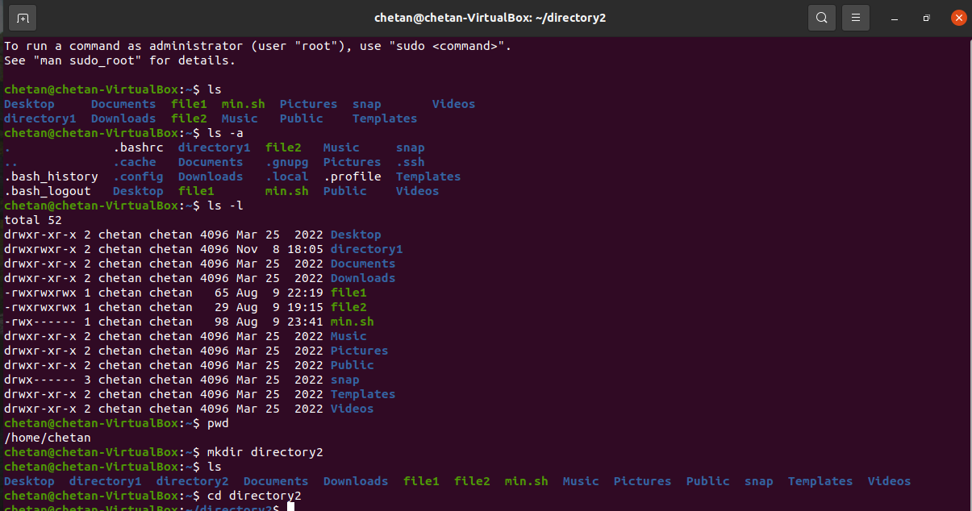
Some Screenshots of command practice

Slide 7
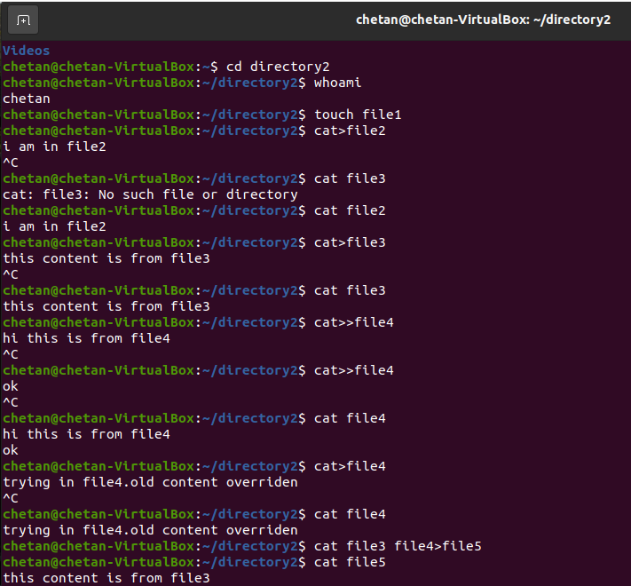
Some Screenshots of command practice

Slide 8
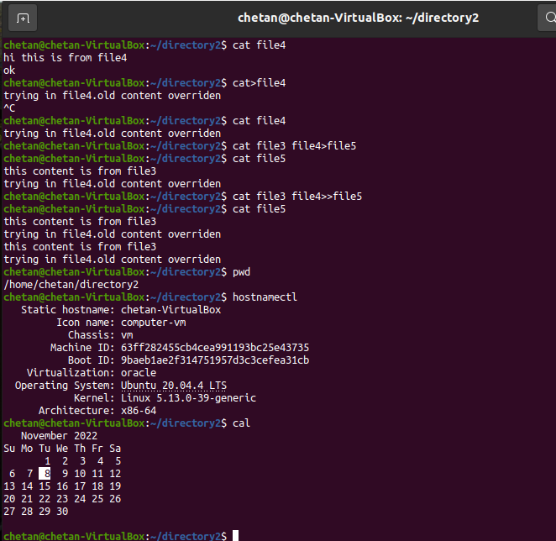
Some Screenshots of command practice

